Slide 1

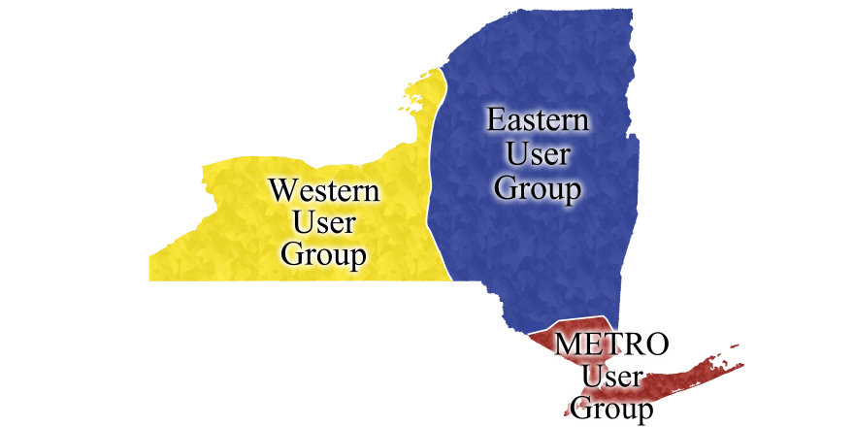
Library Partner Update
Virtual Tour of UB

Slide 2
Local Holdings Deflection
Remember when we talked about local holding deflections during last meeting’s statistics presentation? Here is a quick tutorial!

Slide 3
ILLiad and ILL Basics

Slide 4
Article Licensing Information Availability Service (ALIAS)
ALIAS
Patron Request
IDS Service
Query ISSN, date
ILLIAD
ALIAS: Licensing Database
Awaiting Request Processing – Manual Process
Article Direct Request – Automatic Process
Library Codes for valid dates and licenses
Request Sent to OCLC
Local Holdings Queue

Slide 5
WorldCat Direct Request
Unmediated borrowing loans
Customizable
Great time saver!

Slide 6
Custom Queues

Slide 7
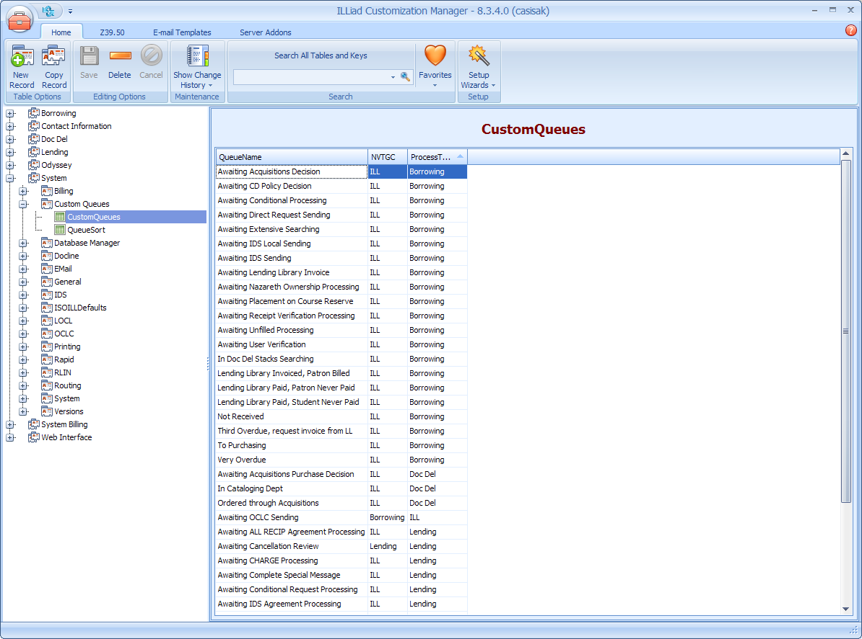
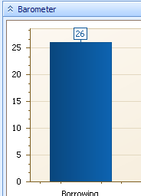
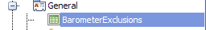
Found in the Customization Manager under System|CustomQueues|CustomQueues
Allows you to route requests out of routine queues for separate or special processing
Use with the Barometer Exclusions Table

Slide 8
Can be used in conjunction with….

Slide 9
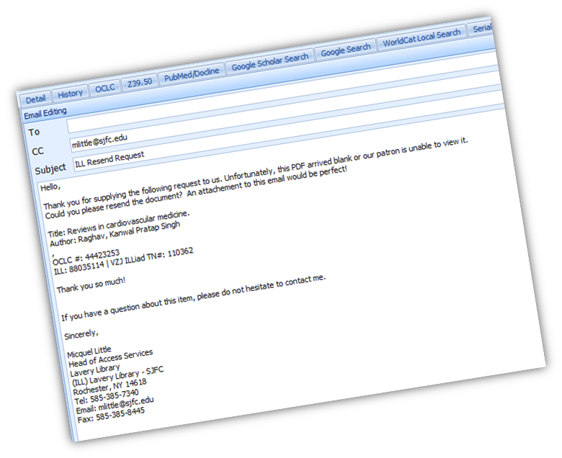
Custom
Emails

Slide 10
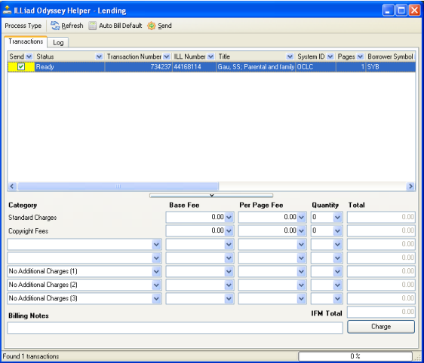
Odyssey

Slide 11

Article Direct Request & Odyssey Trusted Sender
User submits request
Patron Request
Optional quality mediation
2. The borrowing library never touches the request… ALIAS sends, Odyssey receives, ILLiad notifies
Borrowing Library
3. The lending library downloads from eJournal and sends through Odyssey. The staff never photocopies or goes to the stacks…
Lending Library

Slide 12
Policies Directory
Video

Slide 13
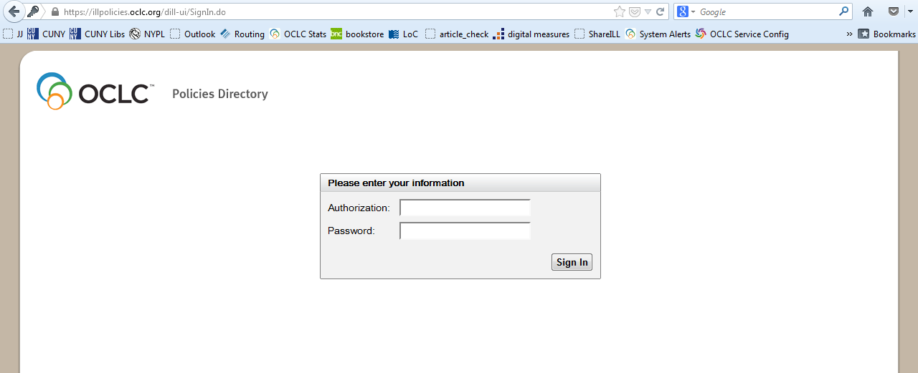
Signing in
1. https://illpolicies.oclc.org/
2. Authorization = 9-digit OCLC number
Password = your OCLC symbol

Slide 14
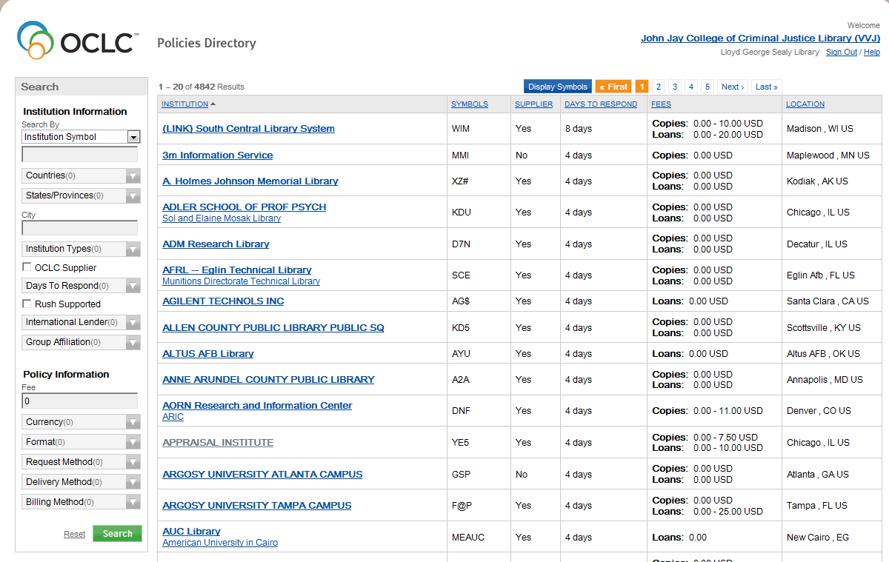
Free lenders
2. For a list of symbols that you can copy into ILLiad, click on “Display Symbols”.
1. Enter zero (0) in the search box under the “Fee” heading and then click on Search. This will generate a list of free lenders.

Slide 15
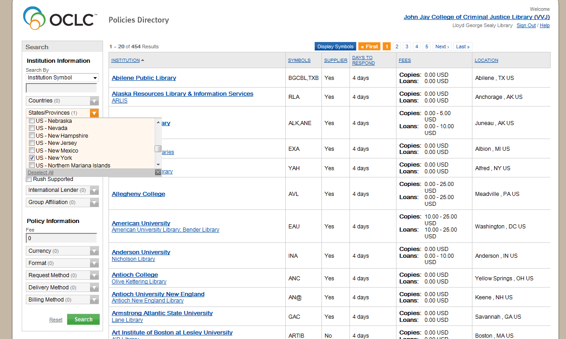
Free lenders in New York State
3. For a list of symbols that you can copy into ILLiad, click on “Display Symbols”.
1. Under the States/Provinces menu, select New York.
2. In the Fee search box type “0”.

Slide 16
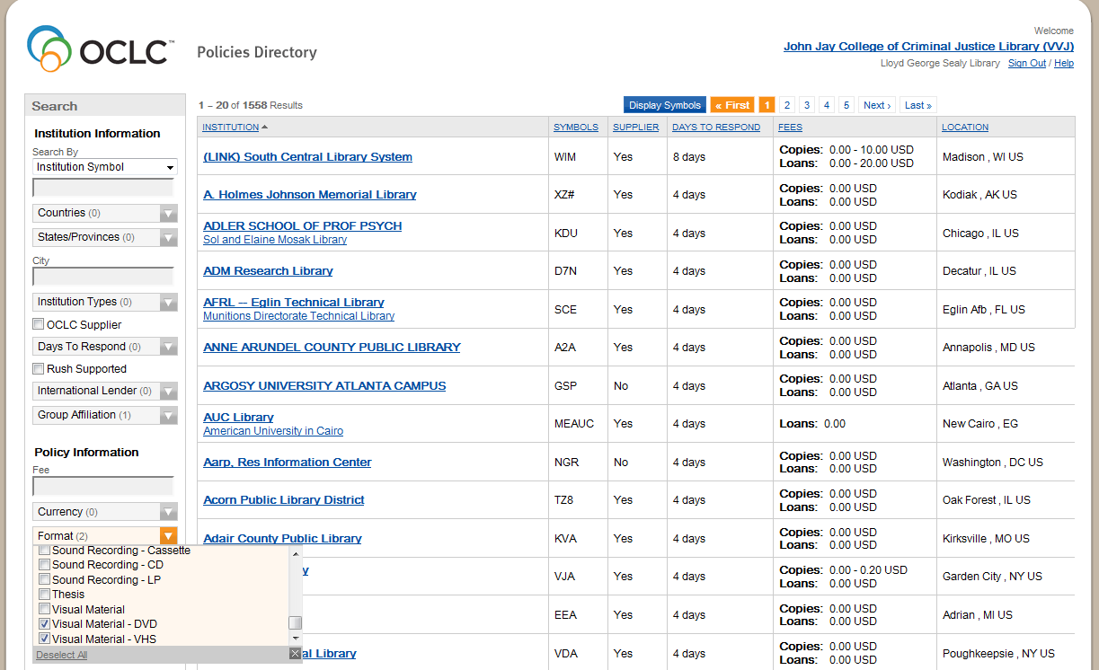
LVIS media
3. For a list of symbols that you can copy into ILLiad, click on “Display Symbols”.
1. From the Group Affiliation menu, select “Libraries Very Interested in Sharing” (LVIS)
2. From the Format menu, select Visual Material – DVD and/or Visual Material – VHS. Note that you can select and search multiple formats.

Slide 17
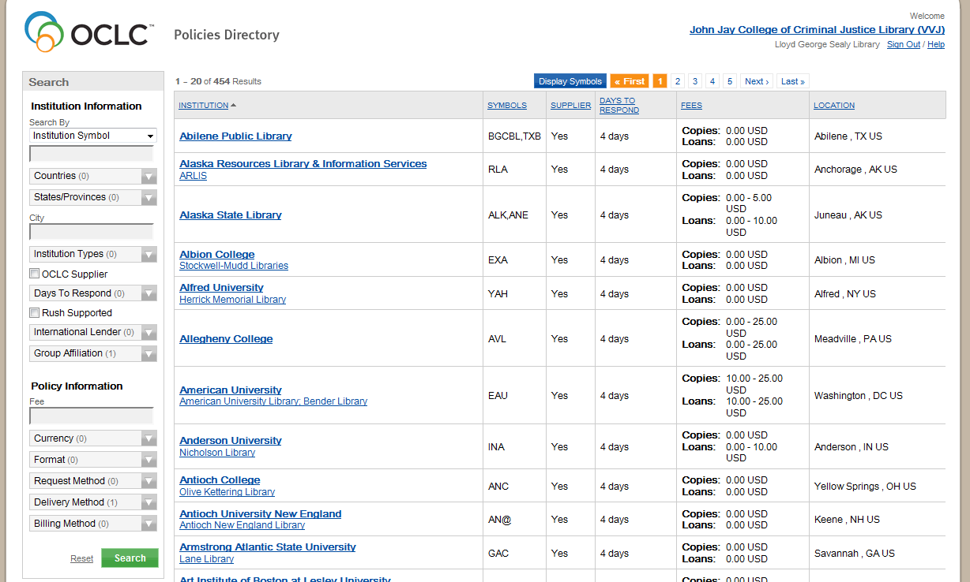
LVIS Odyssey
3. For a list of symbols that you can copy into ILLiad, click on “Display Symbols”.
1. From the Group Affiliation menu, select “Libraries Very Interested in Sharing” (LVIS)
2. From the Delivery Method menu select Odyssey and then click on Search.

Slide 18
Custom Holdings

Slide 19
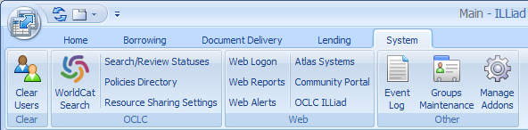
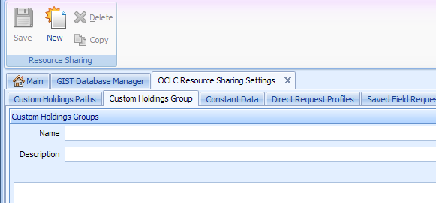
Custom Holdings
1. In ILLiad Client:
open System Tab
Resource Sharing Settings
3. <click> New
2. <click> Custom Holdings Group
4. <Type> a new Name and Description for your Group

Slide 20

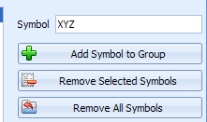
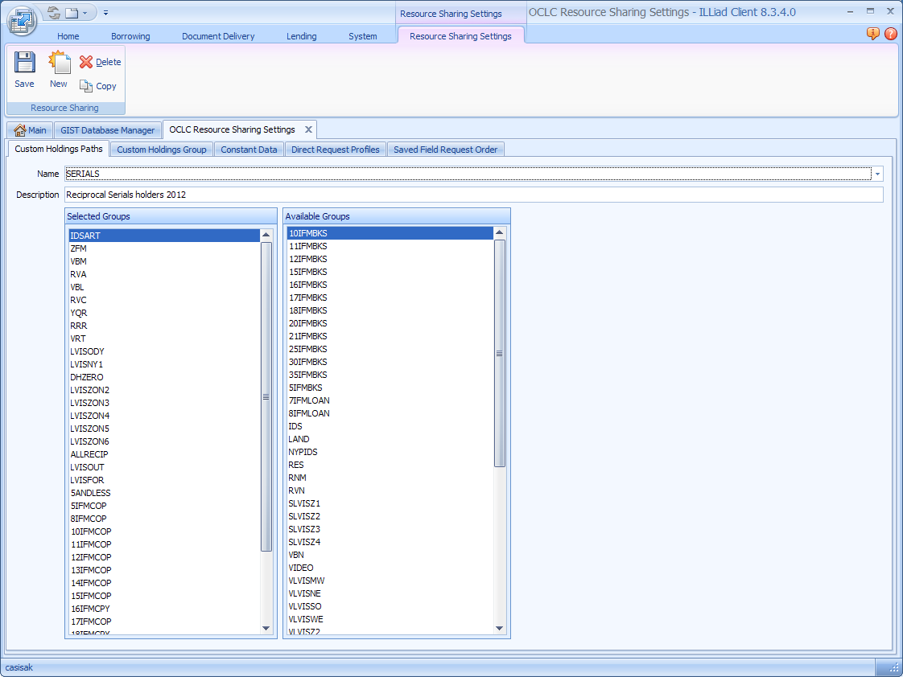
Custom Holdings
5. Add symbols to the Symbol field
6. <click> Add Symbol to Group
7. <click> Save
Don’t forget to add to Custom Holding Paths by clicking and dragging from righ

Slide 21
Custom Holdings
Don’t forget to add to Custom Holding Paths by clicking and dragging from right column to left column.

Slide 22
Lunch!

Slide 23
Tips and Tricks: the Basics

Slide 24
Organizing Queues
  Group related queues into categories
Simple and Convenient

Slide 25
Let’s See!

Slide 26
Organizing Queues
  Group related queues into categories
Rearranging Columns in Queues
  Locating information should be easy…
    Customize and have it make sense to you
Simple and Convenient

Slide 27
Let’s Watch!

Slide 28
Simple and Convenient
Organizing Queues
  Group related queues into categories
Rearranging Columns in Queues
  Locating information should be easy…
    Customize and have it make sense to you
  Quicker response to users’ simple questions
Personalize ILLiad’s Request Template
  Replacing less important information with what you really need

Slide 29
What?! Show that Again!

Slide 30
Copyright:
What is it?
Where is it?
Why is this important?

Slide 31
Copyright: What is it?
The CONTU guidelines
The “Rule of 5”
Permission Practice

Slide 32
Copyright: Where is it?
Copyright Clearance queue
The must have routing rule!

Slide 33
Copyright: Why is this important?
Copyright Report
Tracking
Options for Access

Slide 34
Copyright: No budget?

Slide 35
CCC Get It Now (GIN)

Slide 36
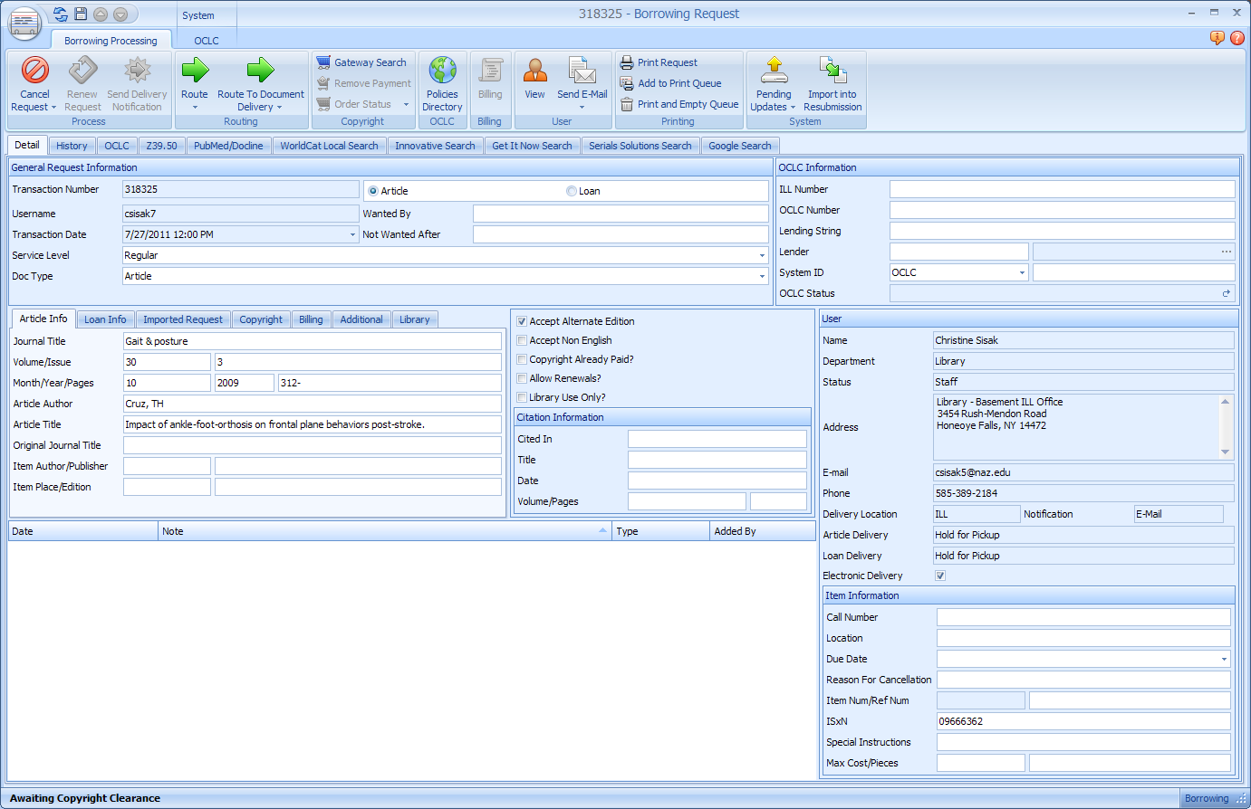
Get It Now option

Slide 37
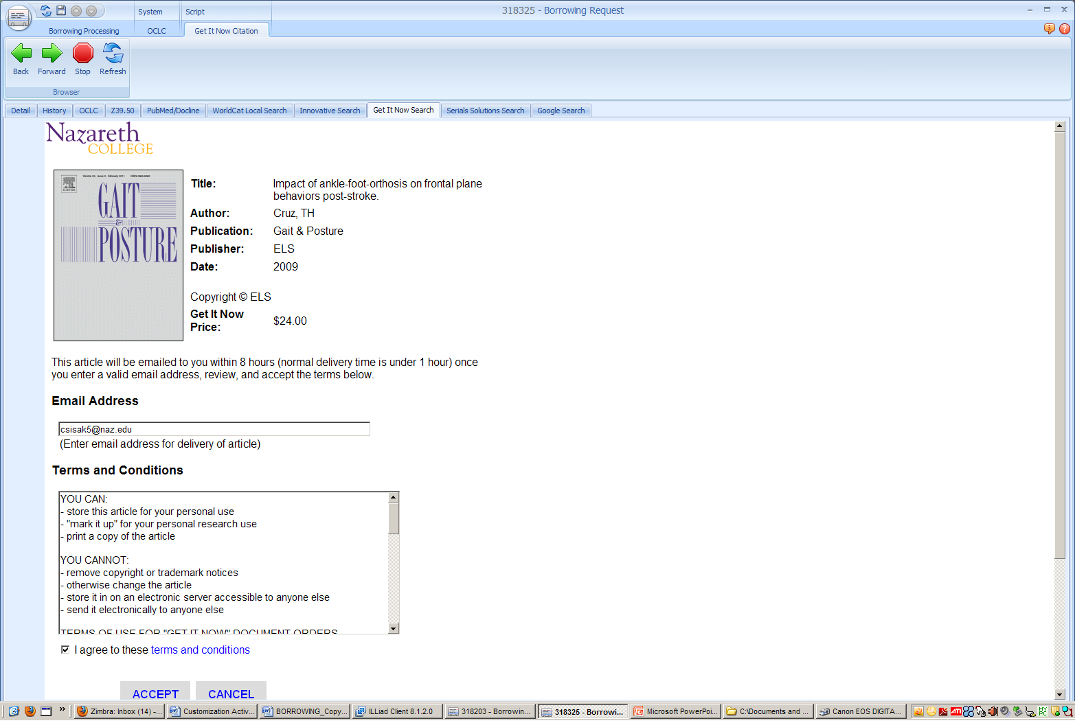
Cost Difference?

Slide 38
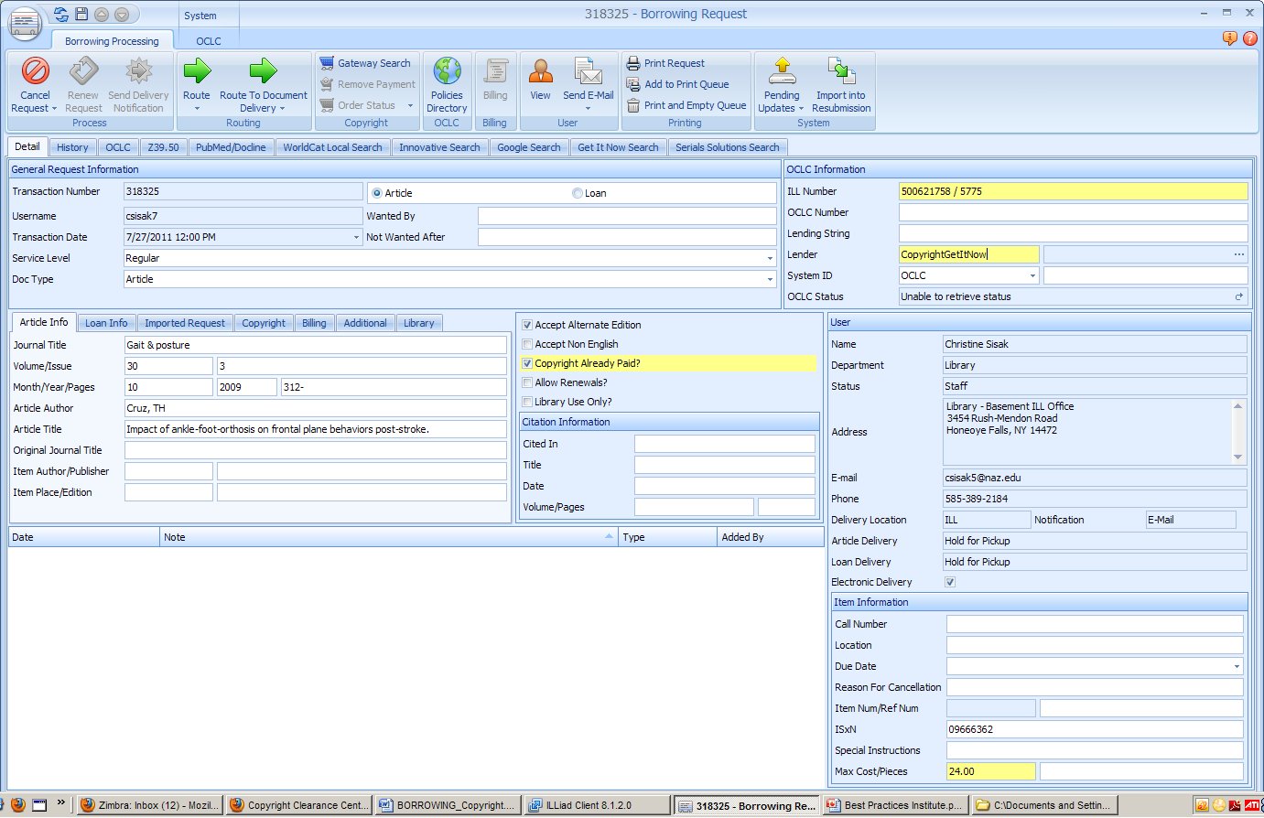

Slide 39
Quick turnaround time
24 x 7 article delivery
Priced less than most royalty fees
Mediated and unmediated options
High-quality, full-color PDF articles
Saves staff time and money
Invoicing from the CCC

Slide 40
Direct purchase from publishers
Not all publishers are on Get It Now
Use your Google Addon or an Addon for a vendor you have an account with
Comparison shop
Don’t have the credit card? Pal up with Acquisitions & sell the savings!

Slide 41
Overdues & Renewals
Challenges in 8.3

Slide 42
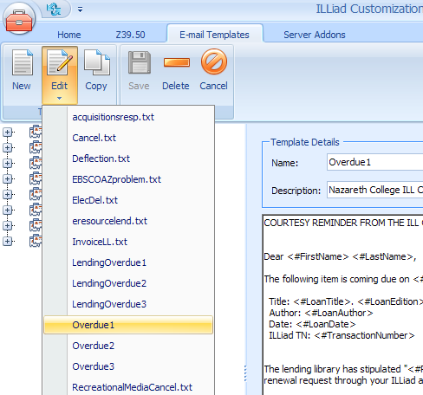
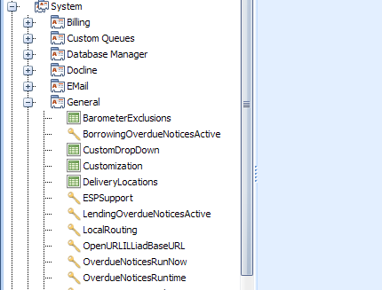
Overdue - pluses
Set it and forget it
  (for initial Courtesy Reminder, Notice 1 and (first) Notice 2)
Email Templates now reside in Customization Manager
Three Keys:
BorrowingOverdueNoticesActive = Yes
LendingOverdueNoticesActive = Yes
OverdueNoticesRunTime = ???

Slide 43

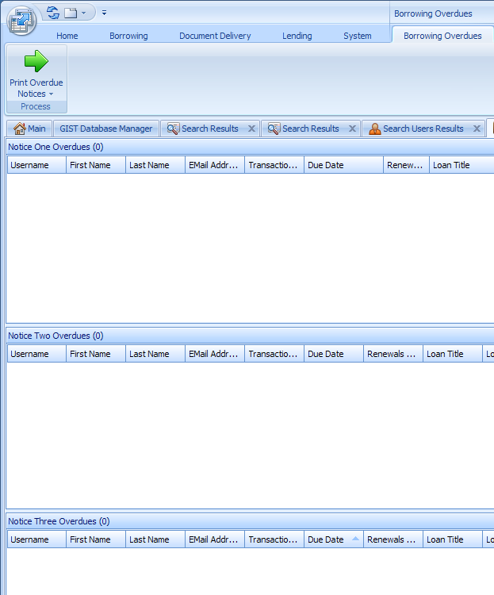
Overdue - Minuses
No “viewing” list
Overdue process stops at the sending of one ‘third’ overdue notice
(AKA: “OverdueNoticeTwo”)
NOTE:
Only patrons and libraries without email addresses will appear here and need Print Overdue Notices processing

Slide 44
The Renewal Problem in 8.3
Overdues were not resetting
Newsflash!
It’s fixed! Upgrade to 8.3.5.0 today!

Slide 45
Two major challenges
ILLiad 8.3 Overdue Problem
Identifying Very Overdue Items
Deciding what to do with your identified items
  A. Leave where they are?
  B. Separate Out?

Slide 46

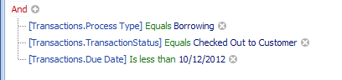
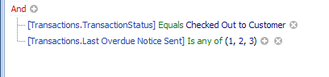
Ways to Identify Very Overdue Items
ILLiad 8.3 Overdue Problem
1) Opening Checked Out to Customer – arranging by due date
2) On IDS Website .irrp Scripts (Custom Request Searches) available to :
  pinpoint recipients of OD 1,2,3
  pinpoint by due date is before ?/?/????

Slide 47
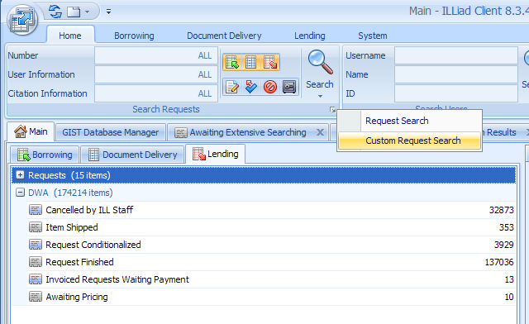
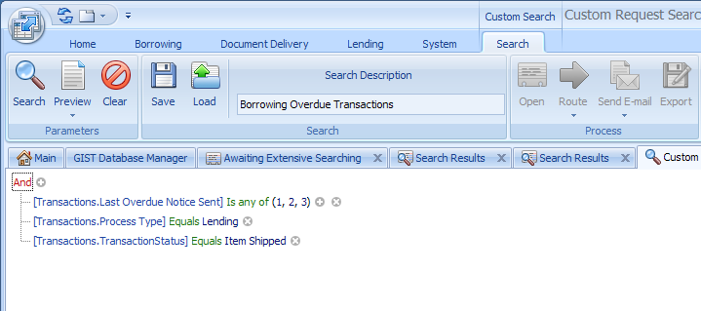
Custom Request Search
1. Open Custom Request Search
2. <click> Load to locate the .irrp file you wish to run.

Slide 48

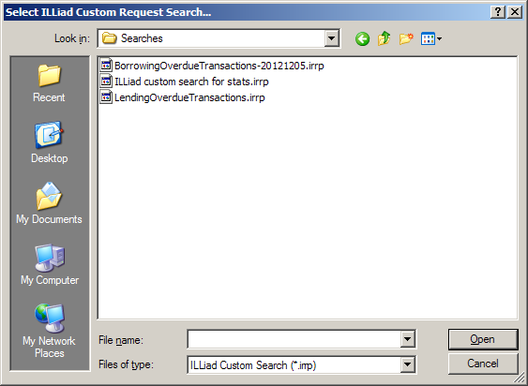
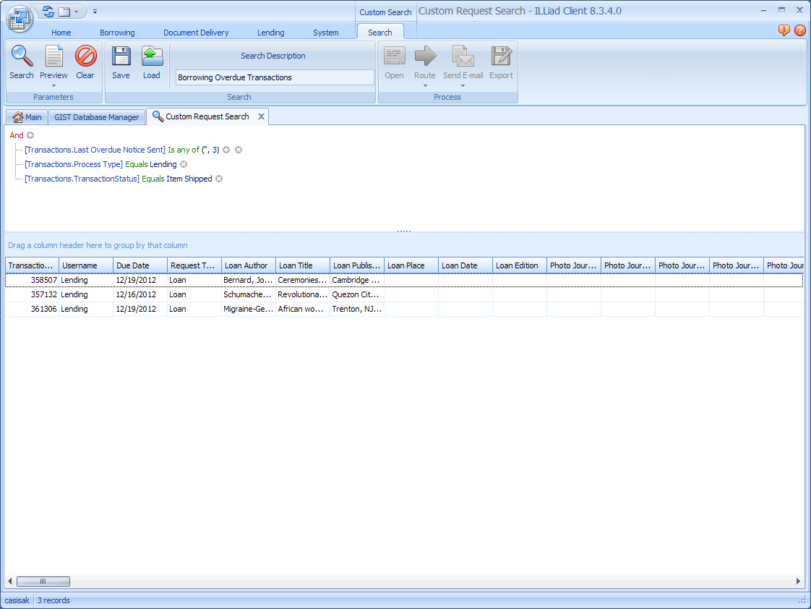
3. By default, searches save in the ILLiad\Searches folder inside ‘My Documents.’ Place any new .irrp files there and they show up automatically!
4. <Click> Open
5. Only want to see 3rd OD recipients?
Delete 1 and 2 from search
6. Your results ordered by
Due Date

Slide 49
Overdues
An Opportunity to Re-examine Workflow
How are you handling very overdue items for both borrowing and lending?

Slide 50
Overdue Video

Slide 51
Additional Information on Overdues
Video Tutorial from Atlas:
http://www.atlas-sys.com/training/tutorials/borrowing/overdue83/player.html

Slide 52
Questions?

Slide 53
Roundtables!

Slide 54
Wrap Up!

Slide 55
Survey in under 4 minutes! http://tinyurl.com/b3pvzwj

Slide 56
IDS Annual Conference 2013
Combined Regional User Groups Meeting
July 31st , 2013
Syracuse, NY
Do you have a topic you would like to present at the Combined User Group Meeting?
Please contact Micquel Little @ 585-385-7340, mlittle@sjfc.edu

